Slide 1
Topic
The overall goal is to see how a business can increase revenue and improve their profit margins.
This will be involving the understanding of a customers experience with a company
Identify specific aspects of products (e.g., price, features, performance) mentioned in reviews and analyze sentiment towards each aspect.

Slide 2
Problem Statement/Hypothesis
Involvement:
Yelp reviews impacting a business the business reputation
Decreasing the overall attraction for their product
How a business can increase revenue and improve their profit margins

Slide 3
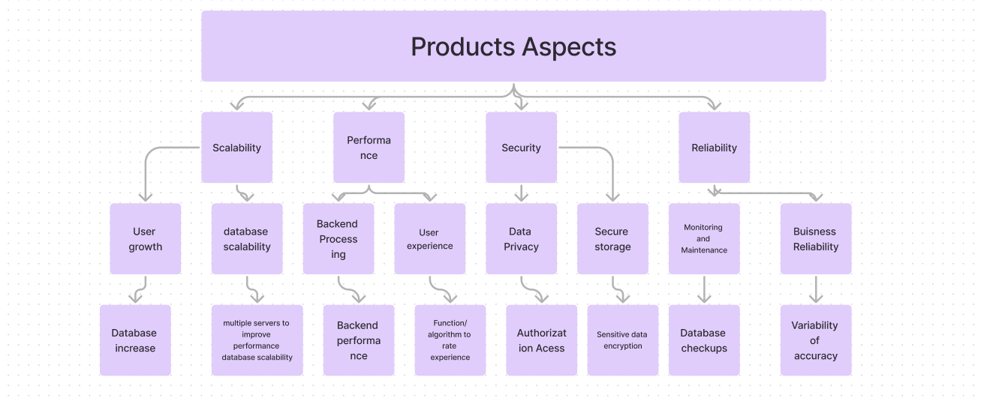
Architecture Diagram

Slide 4
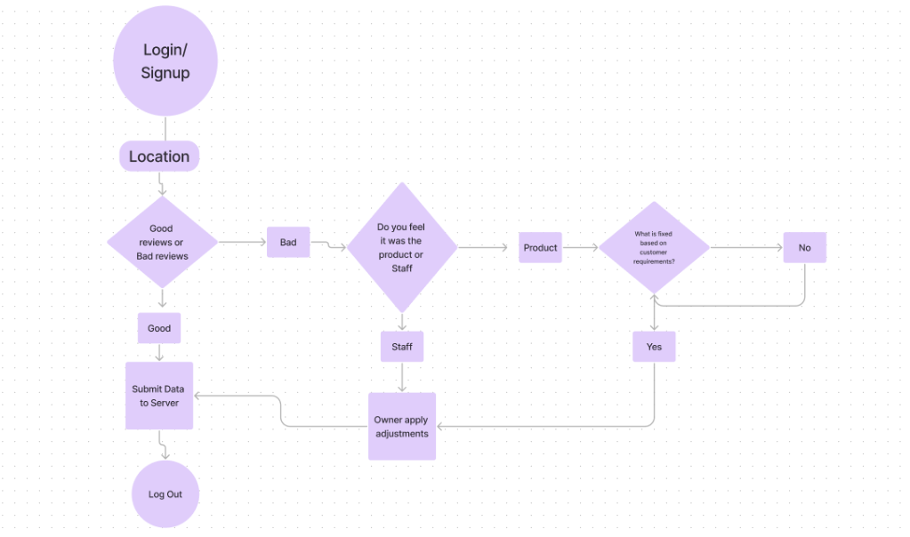
Workflow Diagram

Slide 5
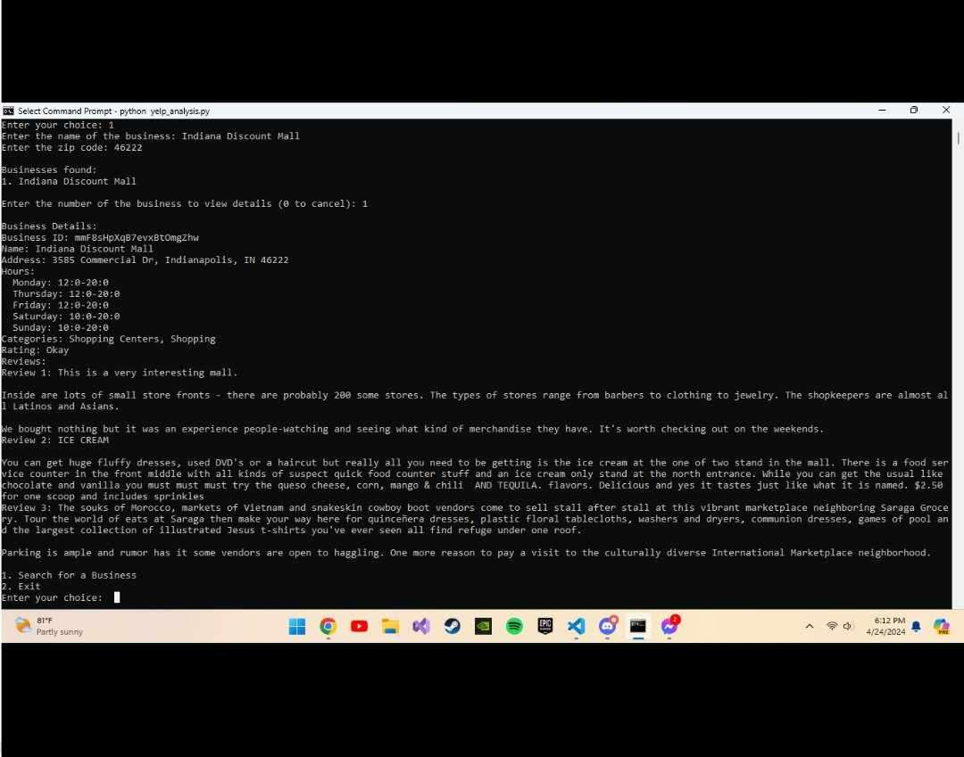
DataSet

Slide 6
Data Analysis

Slide 7
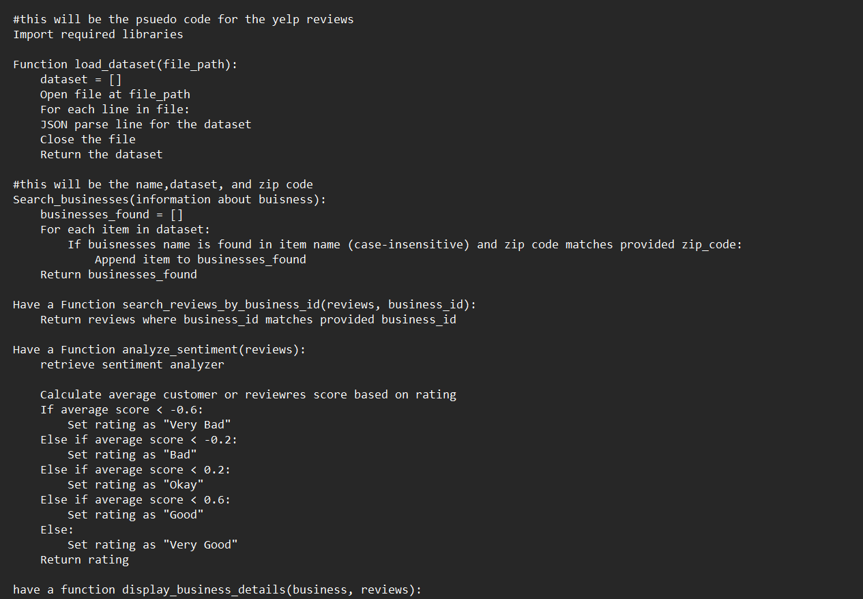
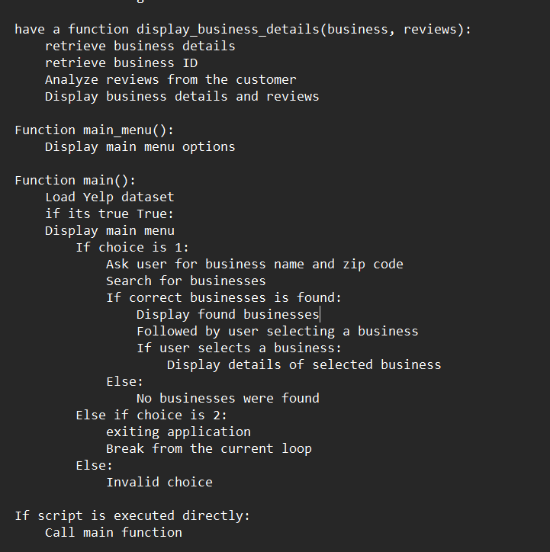
PsuedoCode

Slide 8
Results

Slide 9
Project Management
Sabrina Salazar: Powerpoint, rating system, pseudo code

Slide 10
Refrences

